Slide 1
Hey Cortana, Where Am I?
Danny Warren
@dannydwarren
dannydwarren@gmail.com

Slide 2
About Danny & InterKnowlogy
InterKnowlogy (www.interknowlogy.com)
15 year old services firm – Custom Application Development
Focused on building NUI solutions
Windows Universal Platform (Desktop, Tablet, Phone), Xamarin, WPF, Kinect, Azure
Touch, Gestures (Touchless), & Mouse and Keyboard
Formal R&D program: RECESS
Self guided learning/My time to prepare this presentation
Danny Warren, Sr. Software Engineer
Graduate Neumont University 2009, B.S. C.S.
Microsoft MVP in Windows Platform Development
Since Oct 2013
Former Nokia Champion
Avid Mt. Biker and aspiring Rock Climber

Slide 3
UWP Cortana (Speech) API
Voice Commands
VCD.xml file
Used to launch Apps (Deep Link)
Used to display information provided by VoiceCommandService
Speech Recognition
Grammars
Recognizers
Text-To-Speech (TTS)

Slide 4
Voice Commands
Create VCD.xml File
Register VCD File
Update Phrase Lists
Declare Dictation Phrase Topics
Declare Capabilities in Package.appxmanifest
Microphone
Internet

Slide 5
Text-To-Speech (TTS)
SpeechSynthesizer
.SpeakTextAsync(“string”)
Literally stick words in the phone’s mouth!

Slide 6
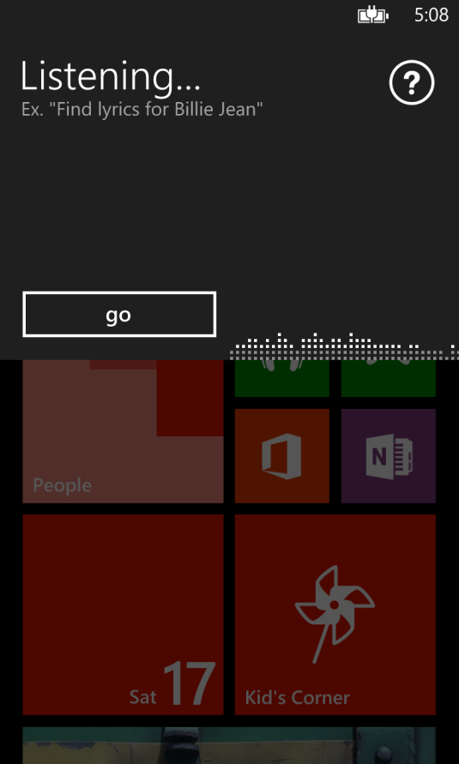

Speech Recognizers
SpeechRecognizerUI
SpeechRecognizer
Uses built in Speech UI
Good for basic uses
App must provide any desired UI for interaction
Good for custom uses

Slide 7
Choosing Between Grammars
Dictation and Web Search Grammar
This is the built in grammar
Must have network connectivity to use
Used by default when no other grammar specified
Programmatic List Grammar
Created in code from a list of strings
Extremely light weight, fast, and accurate
Speech Recognition Grammar Specification (SRGS File)
Extremely flexible
Fast and accurate

Slide 8
Single Shot Location
Geolocator.DesiredAccuracy
Uses
Check-In’s
Placing a geocache
Where am I?
Where did I park?
What country am I in?

Slide 9
Continuous Tracking
Report Interval
Movement Interval
Uses
Running
Mt. Biking
Exercising
Navigation

Slide 10
Best Practices
Use Geolocator.StatusChanged to provide progress feedback to the user
Consider Battery Life
Personally Identifiable Information
Oh, Behave!!!

Slide 11
Download Materials
http://blogs.interknowlogy.com/author/dannywarren/
https://github.com/dannydwarren/Cortana-Location-UWP
Interested in talking more?
Contact Me
dannyw@interknowlogy.com
Mention That Conference

